Slide 1

Operating Systems Design Skilling - I
Instructions to Students
Collect login ID and password from the lab instructor
After first login, change password using passwd command. Don’t reveal password to others.
It is recommended for all students to install Linux along with windows (Dual booting) in their laptop/PC
Students should use putty, connect to the remote Linux server.
In windows, download from https://the.earth.li/~sgtatham/putty/latest/w64/putty.exe
Run and use IP Address:103.206.105.92, port no: 985. Enter the given login ID & Password
In linux,
Open the terminal, connect to the remote Linux server by typing
$ssh remote_username@remote_host -p port_number
$ ssh osd-EMPID@103.206.105.92 -p 985
Enter the given login ID & Password
Or
Issue the below Command to install Putty
# sudo apt-get install putty
After installing, go to Unity Dash or the application menu and find the application putty or Run it from the terminal using “putty” as command. For Host name or IP Address, enter 103.206.105.92, port number 985 and click open.
Use nano editor for typing and saving the programs in the linux server. ^O for save and ^E for exit
$nano program.c

Slide 2
Operating Systems Design Organization of Skilling Component/Exerises
Pre-lab: Bridge course: Linux Administration – Quiz (chapters from Linux command line by William Shotts and NDG LPI )
In-lab:
Explore Xv6 design & implementation.
Xv6 customization/enhancement. Xv6 is designed to be small, compact, easy to understand and modify, and similar in structure to Linux and Unix systems. By the end of the course, not only will you have a bootable operating system of your own, you will also possess practical skills that will directly transfer to industry. The xv6 source code provided for this course is released by MIT.
xv6
Home page of the xv6 project: https://pdos.csail.mit.edu/6.828/2018/xv6.html
Russ Cox, Frans Kaashoek, Robert Morris, xv6: a simple, Unix-like teaching operating system", Revision 11. https://pdos.csail.mit.edu/6.828/2018/xv6/book-rev11.pdf
Frans Kaashoek, Robert Morris, and Russ Cox, The xv6 source code booklet (draft) (revision 11). https://pdos.csail.mit.edu/6.828/2018/xv6/xv6-rev11.pdf

Slide 3

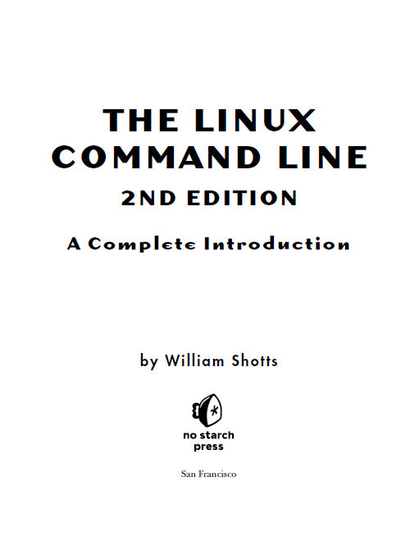
Prescribed book for Linux Administration
Skilling Exercise – I
Practice chapters 1 to 3
PART I: LEARNING THE SHELL
Chapter 1: What Is the Shell?
Chapter 2: Navigation
Chapter 3: Exploring the System

Slide 4
XV6 installation steps ( Download, build and run on Fedora, Centos and Redhat Linux)
Download and Building the xv6 Kernel
vishnu@mannava ~ # yum check-update
vishnu@mannava ~ # yum update
vishnu@mannava ~ # yum install qemu
vishnu@mannava ~ # yum install git
vishnu@mannava ~ # git clone git://github.com/mit-pdos/xv6-public.git xv6
vishnu@mannava ~ # ls
vishnu@mannava ~ # cd xv6
vishnu@mannava ~ # ls
vishnu@mannava ~ # nano Makefile
vishnu@mannava ~ # make
You will boot and run your operating system using QEMU, a powerful emulator offering very good performance. You will not be expected to delve into the QEMU layer of the project. The project is structured so that QEMU “looks” like a native X86 processing environment. The principle advantage of QEMU is that dedicated hardware is not necessary. This environment will greatly speed your learning and also shorten development cycles.
You will run xv6 under the QEMU emulator by using a make command.
vishnu@mannava ~ # make qemu-nox

Slide 5
XV6 installation steps on Ubuntu or any Debian Flavour Linux
vishnu@mannava ~ $ sudo apt-get update
vishnu@mannava ~ $ sudo apt-get upgrade
vishnu@mannava ~ $ sudo apt install make
vishnu@mannava ~ $ sudo apt-get install build-essential
vishnu@mannava ~ $ sudo apt-get install gcc-multilib
vishnu@mannava ~ $ sudo apt-get install qemu
vishnu@mannava ~ $ sudo apt-get install git
vishnu@mannava ~ $ git clone git://github.com/mit-pdos/xv6-public.git xv6
vishnu@mannava ~ $ ls
vishnu@mannava ~ $ cd xv6/
vishnu@mannava xv6 $ ls
vishnu@mannava xv6 $ gedit Makefile
vishnu@mannava xv6 $ make
vishnu@mannava xv6 $ make qemu-nox

Slide 6
Running xv6 under QEMU
A separate window should appear containing the display of the virtual machine. After a few seconds, QEMU's virtual BIOS will load xv6's boot loader from a virtual hard drive image contained in the file xv6.img, and the boot loader will in turn load and run the xv6 kernel. After everything is loaded, you should get a '$' prompt in the xv6 display window and be able to enter commands into the rudimentary but functional xv6 shell. For example, try:
$ ls
. 1 1 512
.. 1 1 512
README 2 2 1844
cat 2 3 12129
...
$ echo Hello!
Hello!
$ cat README
xv6 is a re-implementation of Dennis Ritchie's and Ken Thompson's Unix
Version 6 (v6). xv6 loosely follows the structure and style of v6,
...
$ grep run README
To build xv6 on an x86 ELF machine (like Linux or FreeBSD), run "make".
Then run "make TOOLPREFIX=i386-jos-elf-".
...
$ cat README | grep run | wc
6 70 376
$ echo My New File >newfile
$ cat newfile
My New File
The small file system you're examining and modifying here is resides on a second virtual disk, whose initial contents QEMU initializes from the file fs.img. Later in the course you will examine how xv6 accesses and modifies this file system.

Slide 7
exit xv6 Running under QEMU
To exit xv6, use one of these methods. Note that ”control-a” means to hold down both the control key and the ’a’ key at the same time.
control-a x. This will terminate the QEMU console and so terminate xv6.
control-a c. This will drop you into the QEMU console where you can use “quit” or “q” to exit.

Slide 8
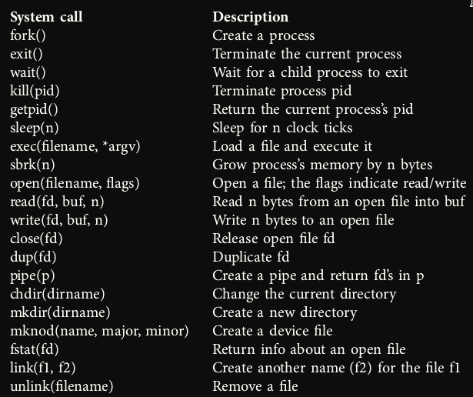
XV6 manual go to page 9, we will find a list of syscalls.

Slide 9
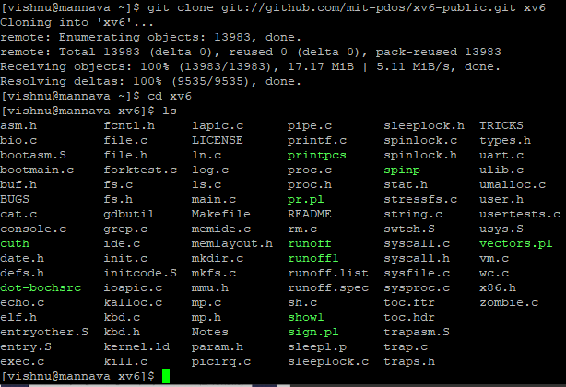
First Look at XV6

Slide 10
First Look at XV6
So, what is XV6? XV6 is an operating system. Other operating systems you may be familiar with are Linux, Windows, and MacOS (which is secretly Unix). Now, if you are reading this, it is probably because you are coding in XV6. The objective of your project likely involves some “kernel hacking,” and, of course, the XV6 source code includes the kernel source code. It also includes some basic user library functionality so that we can write userspace programs for XV6. These are the two main categories for files in XV6: user, and kernel. It is important to understand this separation because, as you know, user-mode programs cannot directly use kernel functionality. User programs must interact with the kernel through “syscalls,” special functions that ask the kernel to execute some kernel code with kernel privileges. First, let’s take a look at XV6.
One of the first things people notice about XV6 is that it has a lot of code. If we do a simple ls…

Slide 11
First Look at XV6
That’s a lot of files! Surely, we don’t have to navigate this ourselves. Let’s turn to an important resource: The manual. The manual is composed of two parts: The manual proper and the code. We will look at the code first. The code is available here: https://pdos.csail.mit.edu/6.828/2018/xv6/xv6-rev11.pdf The first page of the code tells us some important things. First, it tells us how the files are organized:

Slide 12
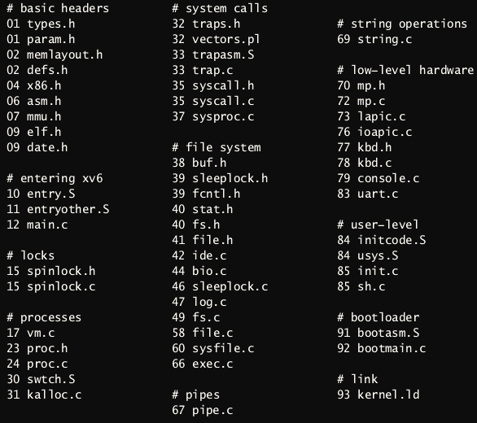
First Look at XV6

Slide 13
First Look at XV6
Notice that things are grouped by their relevance. “Basic Headers” lays out a lot of constants and conventions for XV6. We don’t need to look at those right away. “Entering XV6” is the code that starts XV6. Note that XV6, the operating system, is a program just like any other program that you have ever written. It does have some special requirements, though. Since it is the first code that the CPU runs, it needs some special machinery to set up and launch the kernel itself; this is in entry.S Ignoring that for now, main.c contains the main function for the OS! You could trace it to see how the kernel gets set up, but I will leave that for another time. The “processes” section is also important - these files contain the key machinery for running user programs and enabling OS features like multitasking and multiprogramming. We will not go to a low-enough level in this course to investigate the low-level hardware section. Finally, in the user-level section, init.c contains the code for the first user process. init is always running, until the OS is shut down. An important missing file from this list is user.h, containing the definitions for user-level functionality.

Slide 14
Creating system calls in XV6: int square(int)
XV6 is a UNIX-like operating system that’s used in your OSD class (and other OS classes across the world) for pedagogical purposes.
Creating system calls in XV6 is something you will do frequently as part of my skilling exercises, and in this presentation, I’m documenting how to do that.
Let’s say you want to implement a system call called square that returns the square of its int argument. System calls are overkill to find the square of a number.
The basic idea is to look at how an existing system call is implemented and replicate that. Let’s see what they did to implement getpid(), a relatively simple syscall that gets the process id of the calling process. We will use one of the most useful tools available on most systems in one form or another: grep. This tool just searches for a pattern that you give it among a list of files. No need to dig through every file individually!

Slide 15
Creating system calls in XV6: int square(int)
[vishnu@mannava xv6]$ grep "getpid" -n *
syscall.c:92:extern int sys_getpid(void);
syscall.c:118:[SYS_getpid] sys_getpid,
syscall.h:12:#define SYS_getpid 11
sysproc.c:40:sys_getpid(void)
user.h:22:int getpid(void);
usertests.c:434: ppid = getpid();
usertests.c:1498: ppid = getpid();
usys.S:28:SYSCALL(getpid)
Ignoring the two test calls, it looks like there are five appearances of getpid in the kernel. Most likely, we need to replicate all of them for our square syscall.

Slide 16
Creating system calls in XV6: int square(int)
So, the word “getpid” exists in the following files:
syscall.c : system call handling/dispatch code
syscall.h : system call handling/dispatch code
sysproc.c : process-related system call implementations
user.h : declarations of system call wrappers and standard library functions
usys.S : assembly code (generated by preprocessor macros) for system call wrappers
Most likely, we need to replicate all of them for our square syscall.

Slide 17
Modifications in syscall.h
Now, let’s start with syscall.h. You could’ve started with any other file from the above list; the ordering of things you do is arbitrary. In this file there are lines of the form #define SYS_something and a number. The number increases by 1 as you go downwards. Let’s append #define SYS_square 23 to that file.
// System call numbers
// (The vertical dots `.` indicate that I've skipped over lines).
#define SYS_fork 1
#define SYS_exit 2
.
.
.
#define SYS_close 21
#define SYS_square 22
The highlighted line above indicates the relevant change I made. Keep in mind the “SYS_square” that you chose. We’ll need to refer to it later. “22” is the next number after “21”.

Slide 18
Modifications in syscall.c
If you look at the source code for syscall.c, you’ll see that it contains, among other things, a list of extern int function declarations, and an array of function pointers. So I’m going declare my square function (which I have arbitrarily chosen to name as sys_square), and a corresponding entry in the array.
// (The vertical dots `.` indicate that I've skipped over lines).
extern int sys_chdir(void);
extern int sys_close(void);
.
.
.
extern int sys_uptime(void);
extern int sys_square(void);

Slide 19
Modifications in syscall.c
static int (*syscalls[])(void) = {
[SYS_fork] sys_fork,
[SYS_exit] sys_exit,
.
.
.
[SYS_close] sys_close,
[SYS_square] sys_square,
};
A few things to note here:
The constant inside [] is idential to the one I defined in syscall.h during the previous step.
The datatype of argument of sys_square is written as void, even though we need to pass an int to the function. This will be taken care of later.

Slide 20
Modifications in sysproc.c
Now we go about actually defining sys_square function. At the end of sysproc.c, after sys_uptime(void), define the int sys_square(void) function:
int sys_square(void) {
int num;
argptr(0, (void *)&num, sizeof(num)); // extract and store argument into num
return num * num;
}

Slide 21
Modifications in sysproc.c
Observe that we use a separate function argptr (which is already part of XV6) to extract arguments passed into the function. The parameters of argptr is as follows:
The 1st parameter is the nth argument to extract, starting at 0.
The 2nd parameter is the address of variable to which you want to store the argument, typecast to (void *).
The 3rd parameter is the size of the variable to which you want to store the argument.
This is the usual way to extract arguments passed into system calls.

Slide 22
Modifications in user.h
This is where we want to actually declare the function that the user calls. You should already be seeing a bunch of function declarations in there already. Go ahead and declare this function:
int getpid(void);
.
.
int uptime(void);.
int square(int); // this is what is called from the user-program
This is straightforward. The line that’s relevant to us is highlighted above. Some things to note here:
This function is what would actually be called from a user program.
We are specifying an int parameter.

Slide 23
Modifications in usys.S
We’re almost there. This is the final piece of the puzzle. In the file usys.S, there are lines start with SYSCALL. Append our function to this file, as highlighted below:
SYSCALL(getpid)
.
.
SYSCALL(uptime)
SYSCALL(square)
SYSCALL is a macro that is defined at the top of this file. To be honest with you, I’m not entirely sure what this macro does.
You’re done creating your system call.
To see it in action, create a user program (any .c program), and call the square() function like you normally would.

Slide 24
Let’s Add a Program!
XV6 can run basic user programs. Let’s write a simple one to demonstrate. Primarily, we will be looking at (1) the minor irregularities in the XV6 standard library compared to the standard library that you are used to, and (2) the Makefile.
Create a simple square.c in our XV6 directory.
#include "types.h"
#include "stat.h"
#include "user.h"
int
main(void)
{
printf(1, "square of numbers 7 is %d\n", square(7));
exit();
}

Slide 25
Add square.c in our XV6 directory
Notice a few things. First, printf() has an argument before the string. This the file descriptor that we want to print to; in this case “1” is synonymous with “stdout.” This is closer to how fprintf() is implemented on systems that you are used to. This is just a quirk of the standard library in XV6. You should define “stdout” as “1” somewhere; probably user.h. Also notice that instead of a return, we have a call to exit() that takes no arguments. Returning after main is a special case that is not supported in XV6, so just remember to always exit() at the end of main instead of return. Otherwise, you will get a “trap 14,” which in this case is XV6-speak for “Segmentation Fault.” Finally, notice that our headers are different. There is no #include <stdio.h> as you might be used to. Again, this is because the standard library is different. Check out these headers to see what kind of user utilities you have available.

Slide 26
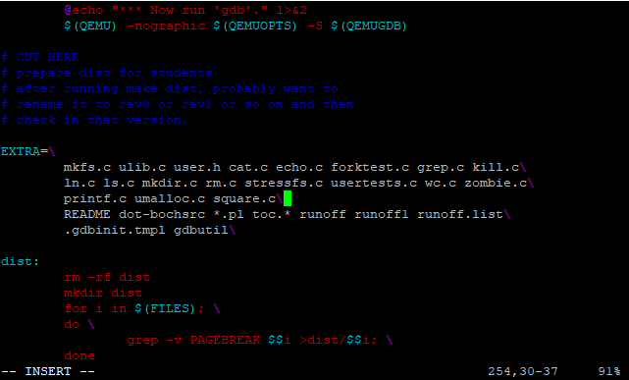
Test user program square.c in XV6
To test this, we need to add the file to our Makefile to be built, as well as include it in the list of files migrated to XV6. First, append the file square.c to the Makefile variable EXTRA.

Slide 27
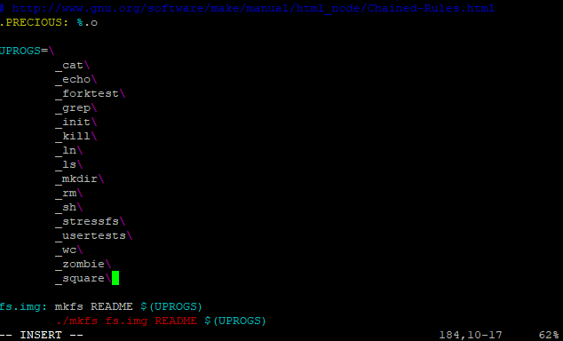
Test user program square.c in XV6
Then, append _square to the Makefile variable UPROGS (user programs).

Slide 28
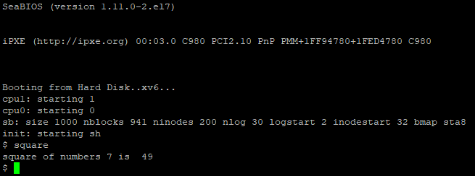
Test user program square.c in XV6
Now, we are ready to try it out!
Run make qemu-nox
Run square

